Slide 1
Practical lesson № 5. CARE for elderly and old people, seriously ill

Slide 2
THEORETICAL QUESTION
Modern age standards were adopted by the European regional Office of WHO (World Health organization) in 1963.
The features of elderly and senile.
Principles for the nursing care of elderly patient.
Injury prevention.
Control pharmacotherapy.
Diet nutrition.
Prevention of chronic constipation.
Prevention of colds.
Control of physical inactivity.
Prevention of insomnia.
Types of the patient positions.
Pressure ulcer. Definition. Causes of pressure ulcer.
Factors contributing to the formation of pressure ulcer.
Places of formation of pressure ulcer.
Pressure ulcer classification.
Principles of prevention of bedsores.
PRACTICAL SKILLS
Wiping the mouth
Eyes care
Ears care
Nose care
Dripping the drops in nose
Dripping the drops in Ears
Dripping the drops in Eyes
Washing the feet in bed
Hair wash in bed
Care of the Perineum (man and woman)
Change of bed and underwear
The use bedpan to patients in bed

Slide 3
Depending on the patient’s condition and doctor’s prescriptions the following types of the patient positions can be :
The position of the patient:
• active
• passive
• forced
The active position is the possibility of self, the active movements. Be aware that for different age categories activity may be different. Please note! Difficult patients can remain active position.
Passive provision is the absence of the patient's ability to self-service (coma, severe weakness, paralysis).
Forced position takes the patient often unconsciously, to ease suffering. However, he is able to change its position independently, but it leads to deterioration of his condition.
As a rule forced position patient is very characteristic of the disease or syndrome.

Slide 4
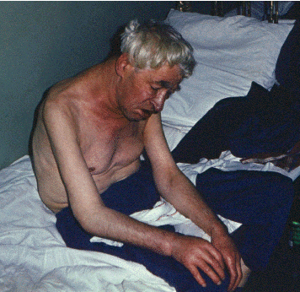
Types of forced position:
1) Forced position - Orthopnea - sitting or lying in bed with a raised head end and lowered his legs.
Disease: heart failure.
A mechanism to ease the condition. The decrease of shortness of breath at the expense of Deposit of the blood in the lower limbs.

Slide 5
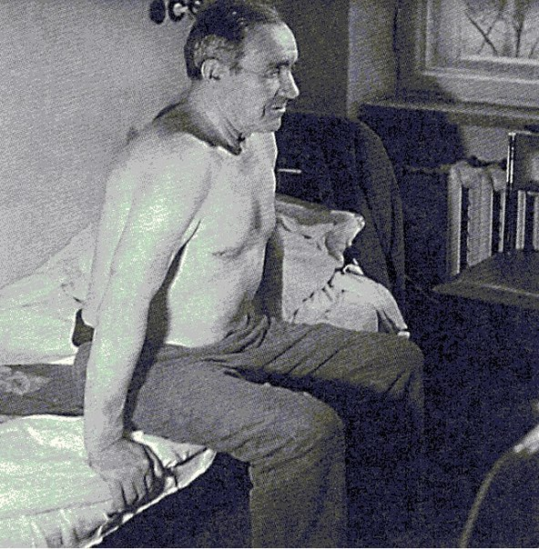
2) Forced position - Orthopnea - a sitting Position, leaning his hands on the edge of the bed Disease: bronchial asthma A mechanism to ease the condition. Mobilization of accessory respiratory muscles, which allows to make exhale active

Slide 6
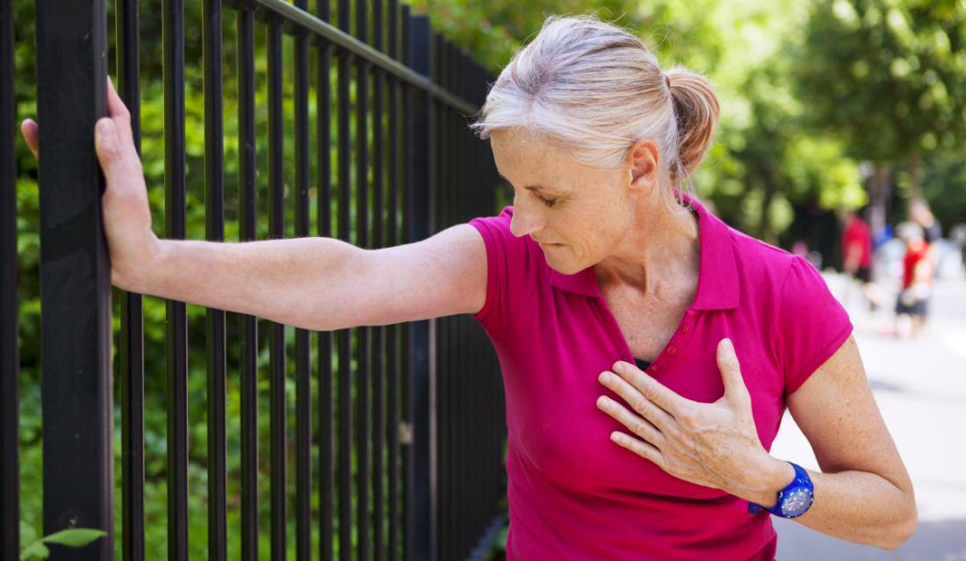
3) Forced position - the standing - symptom "shop window". Because stenokardicheskie pain in the sternum, created by walking, the patient is forced to stop.
Disease: attack of angina
A mechanism to ease the condition. Reducing consumption miocardom oxygen at the termination of movement; facilitating the work of the heart at the expense of Deposit of the blood in the lower extremities

Slide 7
4) Forced position - Pose "praying position " - the patient is sitting on the bed, bent over, resting on the pillow
Disease: Pericardial effusion
A mechanism to ease the condition. In this position, the liquid collects in the bottom part of the fibrous-serous membranes of the heart (the pericardium), and therefore less pressure on the heart and large vessels. "Floating" heart over liquid makes it work.

Slide 8
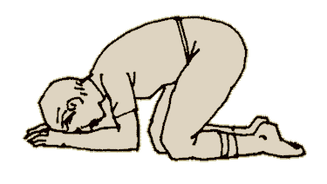
5) Forced position - Position "a la vache" (from French "cow") – is a four standing position.
Disease: tumor of pancreas, stomach or another organ of the abdominal cavity.
Mechanism of relief. In this position the tumor puts less pressure on solar plexus and pain decreases.

Slide 9
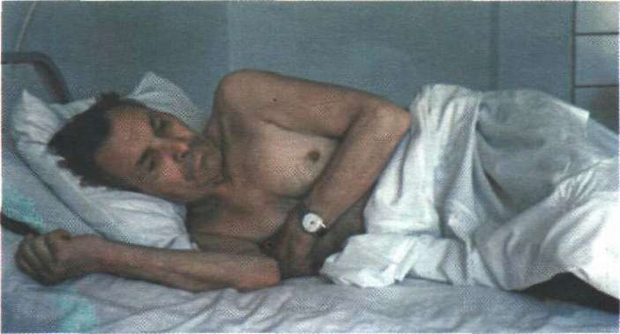
6) Forced position - Lying on a sick side Disease: Dry pleurisy, Rib fracture Mechanism of relief. Limiting of pleural layers friction of the affected side.

Slide 10
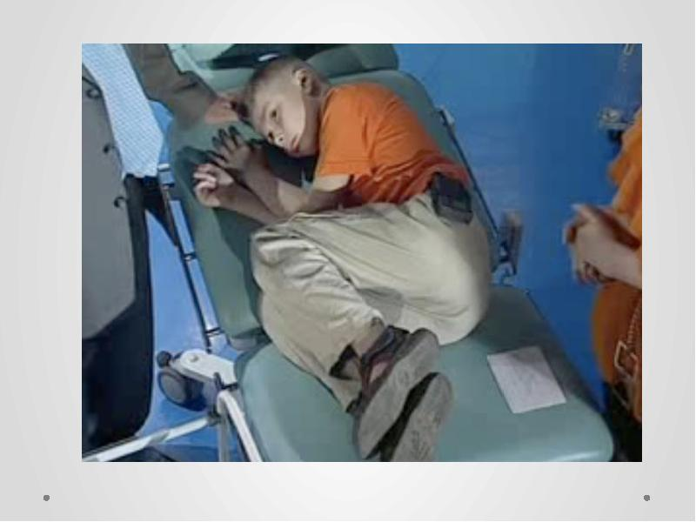
7) Forced position - to sit or lie bended with hands pressed against epigastric region
Disease: gastric Ulcer (localized on a posterior wall)
Mechanism of relief. Acidic gastric juice ebbs away from the ulcer, warm hands reduces paroxysm of unstriated muscles.

Slide 11
8) Forced position - Pointing dog position – the patient lies on the side, with legs bent and pressed against the stomach, the head is thrown back
Disease: Meningitis
Mechanism of relief. This position is caused by lower extremities muscles contracture (Kernig`s symptom) and occipitals contracture (neck stiffness)

Slide 12
Modern age standards were adopted by the European regional Office of WHO (World Health organization) in 1963: Elderly age - 60-74
Gerontal (senil) age - 75-89
Long-livers - 90 and older
The FEATURES of elderly and senile age:
Involutional functional and morphological changes in the various organs and systems. Back development and aging come with age.
Several diseases.
Mostly chronic diseases.
Atypical clinical course of the disease.
The presence of «senile diseases» (osteoporosis, benign prostatic hyperplasia, prostate cancer, Alzheimer's disease and others).
Disorder protective, immune responses.
Disorder of the social and psychological status.
The main causes of social disadaptation. Anxiety, depression, hypochondriac syndrome often develop against this background.

Slide 13
PRINCIPLES FOR THE NURSING CARE of elderly patient:
1. Injury prevention
2. Control pharmacotherapy
3. Diet nutrition
4. Prevention of chronic constipation
5. Prevention of colds
6. Control of physical inactivity
7. Prevention of insomnia
8. Providing personal hygiene of the patient

Slide 14
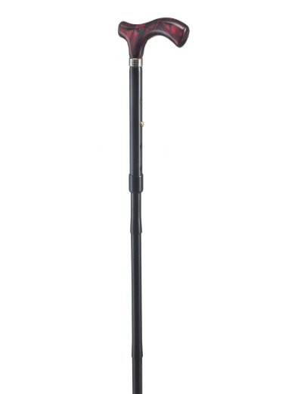
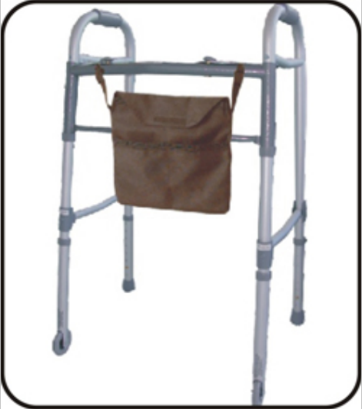
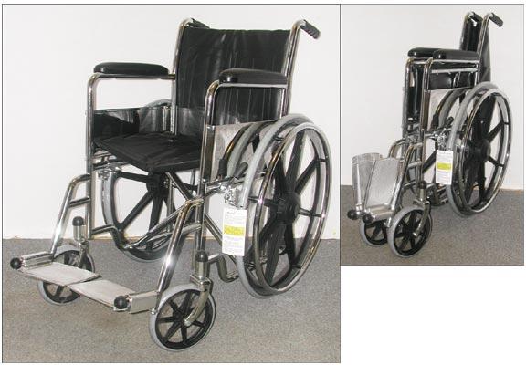
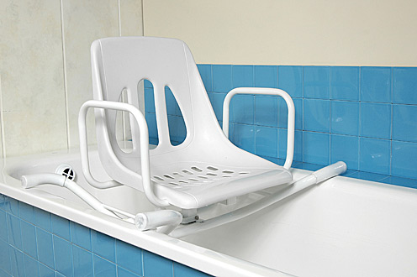
INJURY PREVENTION. Bruise and fracture bones are the most common injury in the elderly patient.
Bruise and fracture bones (especially fracture of neck of femur) violate movement of patients, inevitably lead to complications, such as pneumonia, pulmonary thromboembolism, lead to death.
Injury prevention:
Use of aids for movement if patients has movement violation (cane, auxiliary means for movement- support for hands, wheelchair).
Do not clutter the room with furniture.
Illumination in the night time should have in the corridors and wards.
Floor must be dry (puddles wiped immediately).
Assistance to patients at the bathroom. A nurse is present and helps while bathing; to maintain the patient while getting in and out of bath.

Slide 15
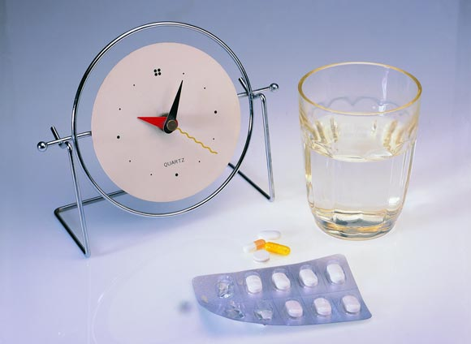
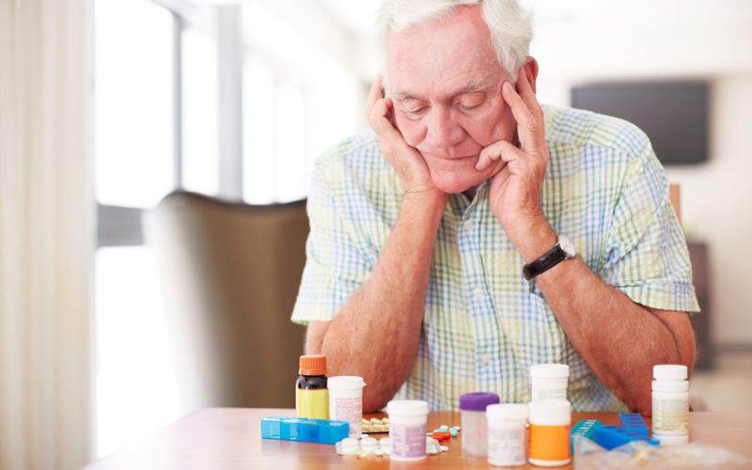
CONTROL PHARMACOTHERAPY:
Dosage of medication
Frequency of intake drugs
Regular intake of medicinal preparation
Features pharmacokinetics (some drugs are taken before a meal, the other drugs after eating)
Optimal combination drugs with food, the other drugs
The nurse should monitor these moments.

Slide 16
DIET NUTRITION Characteristic of diet for elderly patient:
low content of calories
reduced fat
a small volume of food
nutrition should be divided (4 - 5 times a day),
high content of fruit and vegetables.

Slide 17
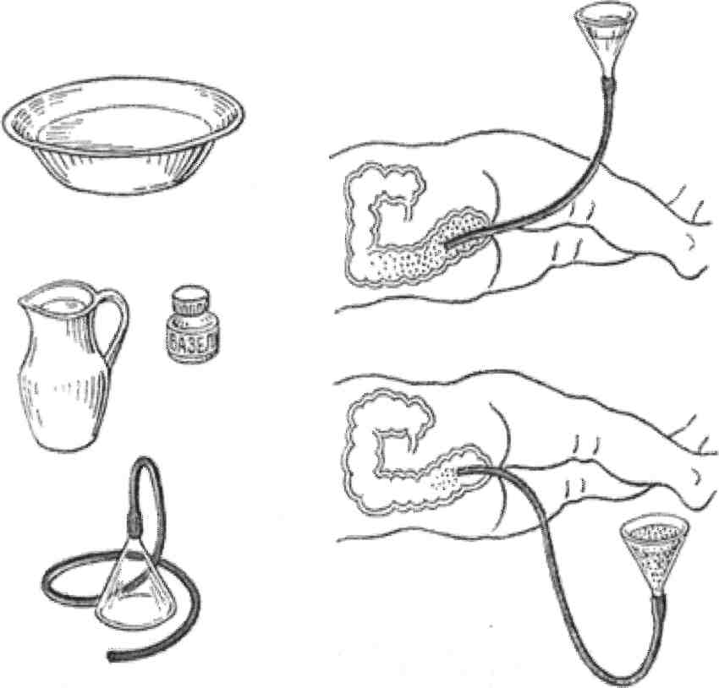
PREVENTION OF CHRONIC CONSTIPATION The nurse should provide (monitor):
regulation of defecation by diet
regular intake of purgative preparation
cleansing enema or oily enema (for chronic constipation)

Slide 18
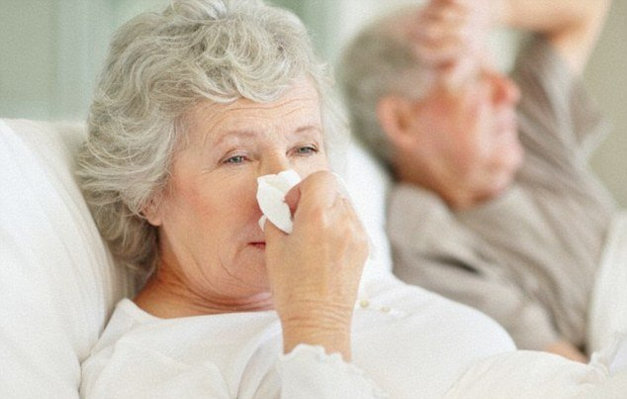
PREVENTION OF COLDS
Duties of a nurse:
The ward should be empty during the ventilation.
Patients should be dressed in accordance with the temperature of environment.
Infectious patients should be isolated.
Elderly and old people are more sensitive to cold drafts.

Slide 19
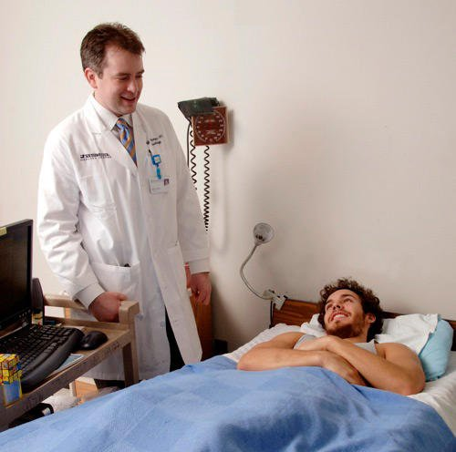
CONTROL OF PHYSICAL INACTIVITY
Medical gymnastics if there are no contraindications
Keep the individual motor mode

Slide 20
PREVENTION OF INSOMNIA
Walk before bedtime
Limit fluid intake before bedtime
Empty the bladder before going to sleep
A warm shower before bedtime
Intake of hypnotics if necessary

Slide 21
PROVIDING PERSONAL HYGIENE OF THE PATIENT
Patients who need help the nurses to provide personal care:
Seriously ill clients.
Paralysed clients.
Unconscious patient.
Malnourished patients.
The nurse performs daily:
Eyes care (daily),
Ears care (daily),
Nose care (daily),
Care of the oral cavity (daily),
Hair care (1 time per seven days),
Skin care (1 time per seven days),
Care of the perineum (daily and after each defecation)
Care of the perineum

Slide 22
WIPING THE MOUTH
Wiping of the mouth is conducted to a seriously ill patient or unconscious.
Purpose: oral hygiene, prevention of inflammatory processes in the oral cavity.
Equipment. Sterile: gauze napkin, medical tray, spatula, dressing forceps, antiseptic solution in measuring glass (0,02% aqueous solution furacin or 0,9% physiological solution of sodium chloride), petrolatum. Towel, gloves, a container for disinfection (tray).
Algorithm:
1.Explain to the patient the purpose and procedure course. Obtain patient’s consent.
2.Conduct hygienic washing hand and processing hand. Put the gloves on.
3.Put the towel around the patient's neck.
4.Lay down the patient in the supine position, raise the head end of the bed at an angle 45° (Fowler‘s position). Turn the head to one side.
5.Take gauze napkin by forceps, moisten with an antiseptic solution.
6.Pull the corner of mouth with a spatula.
7.Process the teeth on the internal side, starting with molars (left and right).
8.Change the gauze napkin.
9.Process the teeth with external side, starting with molars (left and right).
10.Turn the head in other side. Perform manipulation on the other side, changing the gauze napkins.
11.Remove surplus liquid around the mouth by dry gauze napkins.
12.Ask the patient to stick his tongue.
13.Remove fur on tongue (wiping from the root of the tongue to the tip by gauze napkin, moistened in an antiseptic solution.
14.Smear skin with vaseline, if need.
15.Conduct disinfection used material.
16.Take the gloves off and put them in the container for disinfection.
17.Wash hands hygienic way.
18.Make a record of results in a medical documentation.
Remember!
If the patient has plaque on his tongue and lips, first, these places should be smear oil. After a short interval of time gently remove plaque.
19.Oral mucosa of critically ill patients is characterized by dryness. It is recommended to lubricate the oral mucosa by oil (vaseline, olive, peach, sea buckthorn).
20.Dentures must be removed before bedtime and processed. Store in a clean container.

Slide 23
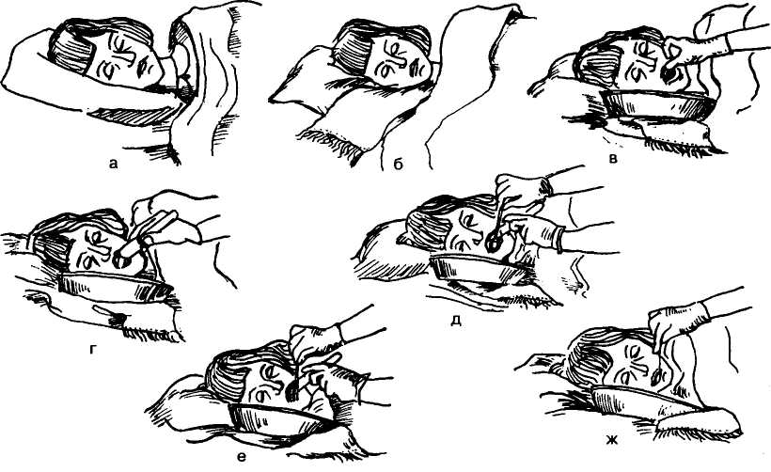
Wiping the mouth

Slide 24
IRRIGATION ORAL CAVITY
Irrigation oral is conducted in the presence in inflammatory changes of the oral mucosa.
Irrigation oral is carried out with antiseptic solutions or drugs.
Purpose: medical.
Equipment. Sterile: gauze napkin, tray, spatula, forceps, syringe of Janet, antiseptic solution in measuring glass (0.02% aqueous solution furacin or 0.9% physiological solution of sodium chloride, the infusion of calendula and chamomile), vaseline, warm boiled water. Unsterile: towel, gloves, a container for disinfection (tray).
Algorithm:
1. Explain to the patient the purpose and procedure course. Obtain patient’s consent.
2. Seat the the patient or lay down his in the Fowler‘s position.
3. Conduct hygienic washing hand and processing hand. Put the gloves on.
4. To cover neck and chest with a towel.
5. Attach the tray to the chin.
6. Ask the patient to close up his teeth. Turn the head to one side.
7. Fill up into the syringe of Janet solution for irrigation.
8. Pull the corner of his mouth with a spatula. Enter the сannula of the syringe into the space between the cheek and teeth.
9. Enter the tip of the syringe Janet in the space between the cheek and teeth.
10. The space between the cheek and teeth wash out with an antiseptic solution.
11. Rinse the mouth with warm boiled water.
12. Turn the head in other side. Perform manipulation on the other hand.
13. Remove surplus liquid from by dry gauze napkin.
14. Conduct disinfection used material.
15. Take the gloves off and put them in the container for disinfection.
16. Wash hands hygienic way.
17. Make a record of results in a medical documentation.
Remember!
Remove dentures before performing this procedure.
Oral irrigation is strictly prohibited carry out by patient in unconsciousness. Liquid can get into the respiratory tract, may develop asphyxia.
Wiping of the mouth should always be preceded the irrigation oral.

Slide 25
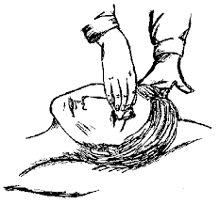
Сare of eyes
A common problem of the eyes are secretions that dry on the lashes as crusts. This may need to be softened and wiped away under sterile conditions. Eyes are cleaned from the outer to the inner canthus. When sterile procedure is required, each eye is cleaned with separate swabs, swabbing each eye once only. This prevent spread of infection from one eye to other and to avoid possible recontamination of the same eye.
WIPING THE EYE
Purpose: prevention of inflammatory eye diseases.
Equipment. Sterile: tray, gauze napkins, tweezers, antiseptic solution in measuring glass (0.02% aqueous solution furacin). Unsterile: gloves, a container for disinfection (tray).
Algorithm:
Explain to the patient the purpose and procedure course. Obtain patient’s consent.
Conduct hygienic washing hand and processing hand.
Put the gloves on.
Inspect the eyes, assess the condition.
Take a gauze napkin with tweezers, moisten in an antiseptic solution, take the gauze napkin in your right hand.
Wipe eyelid in the direction from external corner of the eye to the internal. Use several gauze napkins, if necessary.
Then wipe eyelid with a dry gauze napkin in the same direction.
Similarly treat the other eye.
Conduct disinfection used material.
Take the gloves off and put them in the container for disinfection.
Wash hands in hygienic way .
Make a record of results in a medical documentation.

Slide 26
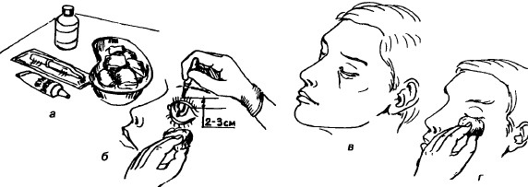
DRIPPING THE DROPS IN EYES
Purpose: medical
Equipment . Sterile: pipette, gauze napkins, a drug, tray. Unsterile: gloves, container for disinfection (tray).
Algorithm:
Explain to the patient the purpose and procedure course. Obtain patient’s consent.
Conduct hygienic washing hand and processing hand. Put the gloves on.
Seat the patient face to light. Gently tilt the head or put on the back without a pillow. Offer the patient to look up.
Check the name of medicine. Check the concentration and dose of the medicament.
Take the pipette in your right hand. Put the medicament in the pipette.
In the left hand take a gauze napkin.
Apply the gauze napkin to the inferior eyelid .
Pull the lower eyelid down.
Drip 1-2 drops of the drug in the conjunctival sac. Closer to the nose.
Residues of drug wipe with gauze napkin.
Сhange the gauze napkin.
Drip drops in the other eye.
Conduct disinfection used material.
Take the gloves off and put them in the container for disinfection.
Wash hands hygienic way.
Make a record of results in a medical documentation.

Slide 27
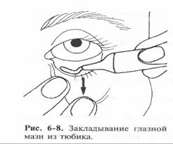
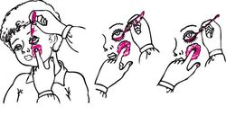
LAYING OPHTHALMIC OINTMENT TO THE LOWER EYELID FROM THE TUBE
Purpose: medical.
Equipment. Sterile: gauze napkins, tray tube of ointment. Gloves, tray, container for disinfection (tray).
Algorithm:
Explain to the patient the purpose and procedure course. Obtain patient’s consent.
Conduct hygienic washing hand and processing hand. Put the gloves on.
Seat the patient face to light. Gently tilt the head back or lay patient on his back without a pillow. Offer the patient to look up.
Take the gauze napkin in the left hand. Attach the gauze napkin to the inferior eyelid . Pull the lower eyelid down.
Use your right hand to squeeze the ointment from the tube on the conjunctiva of the lower eyelid. From the internal to the external corner of the eye.
Release the lower eyelid and ointment is pressed against the eyeball.
Put in the other eye ointment. Use a new gauze napkin .
Conduct disinfection used material.
Take the gloves off and put them in the container for disinfection.
Wash hands hygienic way.
Make a record of results in a medical documentation.

Slide 28
Care of nose and ears
The nose and ears require minimal care in the daily life. Excessive accumulation of secretions make the client sniff or blow the nose. The secretions can become crusted and obstruct the airway (another nares).
For patients who cannot remove the secretions, assistance is necessary to clear the congestion and protect the nasal mucosa. External crusted secretions can be removed with a wet wash cloth or a cotton applicator moistened with oil, normal saline or water.
When there is poor hygiene of the ears, debris may accumulate behind the ear and the anterior aspect of the external ear. This can lead to ulceration of the skin. A common problem of the ears is the collection of cerumen or ear wax in the external auditory canal. This may cause a person some difficulty in hearing.
It can cause discomfort when it hardens. Many people remove wax from their ears by using sharp objects which can traumatize the ear drum. Warm liquid or a vegetable oil instilled into the ear can soften the wax and it can be easily removed.

Slide 29
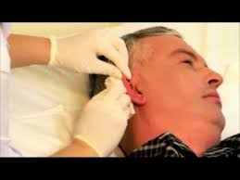
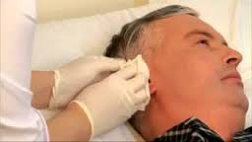
EAR CARE
Purpose: warning hearing loss due to the accumulation of sulfur.
Equipment. Sterile: tray, cotton turundas, 3% hydrogen peroxide solution in measuring glass ,
antiseptic solution in measuring glass, gauze napkin. Gloves, tray, container for disinfection (tray).
Algorithm:
Explain to the patient the purpose and procedure course. Obtain patient’s consent.
Conduct hygienic washing hand and processing hand. Put the gloves on.
Turn the head to one side.
Use tweezers to moisten the gauze in an antiseptic solution.
Wipe the outside of the ear. Wipe the inside of the ear.
Using tweezers, moisten a cotton turunda with 3% solution of hydrogen peroxide.
Put the turunda in the right hand.
With the left hand pull the ear of the patient to the side and up. For straightening of the auditory canal.
Enter the turunda with rotational movements in the external auditory canal to a depth of 1 cm.
Leave cotton turunda in the ear canal for 2-3 minutes.
Remove the turunda with rotational movements in the same direction.
Turn the head in other side. Perform manipulation on the other side.
Conduct disinfection used material.
Take the gloves off and put them in the container for disinfection.
Wash hands hygienic way.
Make a record of results in a medical documentation.

Slide 30
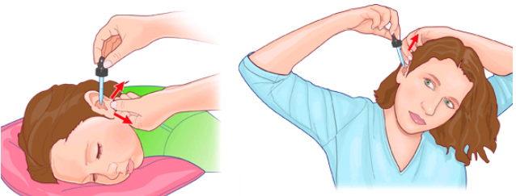
Dripping the drops in ears
Purpose: preventive, curative.
Equipment. Sterile: pipette, cotton turundas, tray, warm ear drops. Gloves, container for disinfection (tray).
Algorithm:
Explain to the patient the purpose and procedure course. Obtain patient’s consent.
Conduct hygienic washing hand and processing hand. Put the gloves on.
Seat the patient or lay down. Turn the head to the opposite side (tilt the head if the patient sits).
Take the pipette in your right hand. Put the medicament in the pipette.
With the left hand pull the ear of the patient to the side and up. Instillation ear drops (3-5 drops).
Leave the patient in this position as long as necessary to get the needed effect (from 1 to 15 minutes).
Turn the head in other side. Perform manipulation on the other side.
Conduct disinfection used material.
Take the gloves off and put them in the container for disinfection.
Wash hands hygienic way.
Make a record of results in a medical documentation.
Remember!
The ear canal should be cleaned before installation of the drops.
The drug needs to be heated in a water bath to 37 ̊ C before instillation.

Slide 31
LAYING THE OINTMENT TO THE EAR
Purpose: medical.
Equipment. Sterile: cotton turundas, ointment, tray. Gloves, container for disinfection (tray).
Algorithm:
Explain to the patient the purpose and procedure course. Obtain patient’s consent.
Conduct hygienic washing hand and processing hand. Put the gloves on.
Seat the patient or lay down. Turn the head to the opposite side (tilt the head if the patient sits).
Apply the ointment a sterile cotton turunda.
With the left hand pull the ear of the patient to the side and up.
Enter the turunda with rotational movements in the external auditory canal.
Turn the head in other side. Perform manipulation on the other side.
Conduct disinfection used material.
Take the gloves off and put them in the container for disinfection.
Wash hands hygienic way.
Make a record of results in a medical documentation.
Remember! The ear canal should be cleaned before introduction of ointment in the ear.

Slide 32
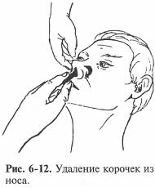
Treatment of the nasal passages
Objective: To prevent violation of nasal breathing.
Equipment. Sterile: pipette, cotton turundas, tray, oil (vaseline, sea buckthorn and more). Gloves, container for disinfection (tray).
Algorithm:
Explain to the patient the purpose and procedure course. Obtain patient’s consent.
Conduct hygienic washing hand and processing hand. Put the gloves on.
Seat the patient or lay down. Gently tilt the head back.
Take the cotton turunda with tweezers. Moisten a cotton turunda in vaseline oil. Put on the turunda in the right hand.
Enter the cotton turunda into the nasal passage. Leave in for 2-3 minutes.
Remove turunda with rotational movements in the same direction.
Remove the turunda together with softened crusts (with rotational movements in the same direction).
Conduct disinfection used material.
Take the gloves off and put them in the container for disinfection.
Wash hands hygienic way.
Make a record of results in a medical documentation.

Slide 33
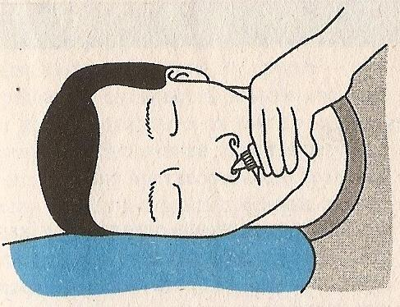
Dripping the drops in nose
Purpose: medical.
Equipment . Sterile: cotton balls, tray, pipette (or individual bottle), drug. Non-sterile: gloves, container for disinfection (tray).
Algorithm:
Explain to the patient the purpose and procedure course. Obtain patient’s consent.
Conduct hygienic washing hand and processing hand. Put the gloves on.
Seat the patient or lay down. Gently tilt the head to the side instillation.
Take the cotton balls in the left hand. Press them to the palm of the little finger.
Put the pipette in your right hand. Put the medicament in the pipette.
Raise the tip of the nose with your left thumb.
Enter the pipette in the nasal passage to a depth of 1-1.5 cm, without touching the walls.
Drip 4-5 drops in the nasal passage.
Compress the wing of nostril with a cotton ball.
Turn the head in other side. Perform manipulation on the other side.
Conduct disinfection used material.
Take the gloves off and put them in the container for disinfection.
Wash hands hygienic way.
Make a record of results in a medical documentation.

Slide 34
Practical lesson № 6. Pressure ulcer

Slide 35
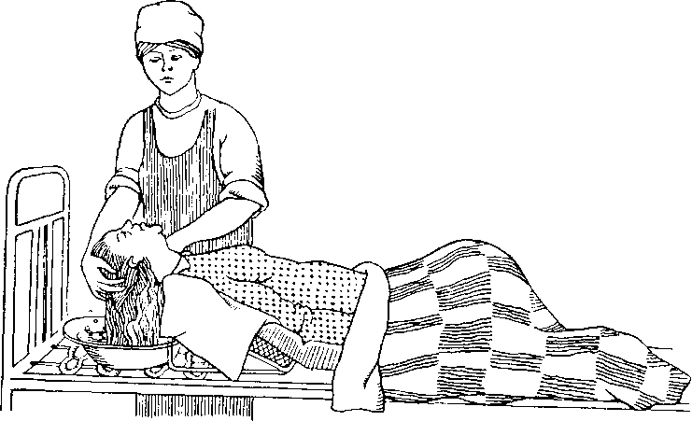
Hair wash in bed
Algorithm:
Explain to the patient the purpose and procedure course. Obtain patient’s consent.
Close windows, doors. Put a screen.
Conduct hygienic washing hand and processing hand. Put the gloves on. Wear apron. Prepare the equipment.
Inspect the patient 's head.
Lay down the patient on his back.
Remove the pillow.
Put under the head an oilcloth.
Put the headrest under the shoulders of the patient.
Put the basin near the head. Put the hair into the basin.
Moisten the hair with warm water. Pour water from a jug on the head.
Apply shampoo.
Well rinse out the shampoo of the hair. Wipe the hair.
Gently comb the hair, well dry.
Remove the apron.
Conduct disinfection used material.
Take the gloves off and put them in the container for disinfection.
Wash hands hygienic way.
Make a record of results in a medical documentation.
Patients require constant observing for their hair. Seriously ill head washed in bed.
Remember ! Long hair is better to braid in two plaits. To make it comfortable to lie. To fix the hair do not use metal clips.
Purpose: personal hygiene of the patient.
Equipment: capacity with warm water, a basin, a headrest, oilcloth, towel, shampoo, individual comb, gloves, waterproof apron, a container for dirty linen.

Slide 36
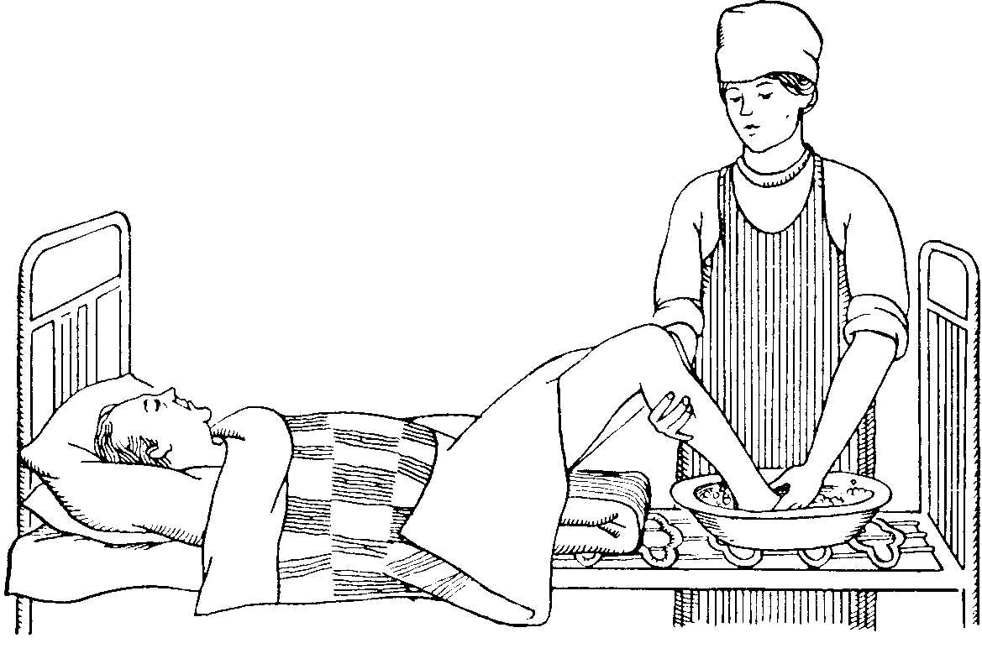
Washing the feet in bed
Algorithm:
1.Explain to the patient the purpose and procedure course. Obtain patient’s consent.
2.Put a screen. Prepare the equipment.
3.Conduct hygienic washing hand and processing hand. Put the gloves on. Wear apron.
4.Lay down the patient on his back. Bend patients knees.
5.Remove the mattress from under the feet.
6.Put under the feet an oilcloth. Put at the oilcloth a basin with warm water.
7.Put the patient's feet in the basin with water.
8.Wash the feet with a sponge and soap.
9.Wash in the following order: shin, foot, between the toes, sole.
10.Remove the basin.
11.Dry feet. Cut nails. Lubricate with cream.
12.Remove oilcloth, put in order the bed.
13.Disinfect used material.
14.Remove gloves, put them in a container for disinfection.
15.Wash hands hygienic way.
16.Make a record of results in a medical documentation.
Purpose: prevention of diaper rash between the toes.
Equipment: a basin of warm water, oilcloth, apron, towel, soap, sponge, gloves, scissors, cream, container for disinfection.

Slide 37
Care of the Perineum
Perineal hygiene involves cleaning the external genitalia and surrounding area. The perineal area is conducive to the growth of pathogenic organisms because it is warm, moist and is not well ventilated. Since there are many orifices (urinary meatus, vaginal orifice and the anus) situated in this area, the pathogenic organisms can enter into the body. Thorough cleanliness is essential to prevent bad odour and to promote comfort.
The most pertinent principle for the perineal care is to clean the perineum from the cleanest to the less clean area. The urethral orifice is considered as the dirtiest area. Because the orifices in the perineal area are in proximity, cross contamination is potential problem.The normal flora of the urinary system is different from that in the gastrointestinal system. Entry of organisms from the anal orifice can cause urinary tract infections, because these organisms are foreign to the urinary tract.
When implementation of personal hygiene all movements should be performed in the direction from the urethra to anus. This is necessary for the prevention of urinary tract infections pathogens which are most likely to be microorganisms are natural inhabitants of the intestine.

Slide 38
The following clients require special attention to the perineal area:
Patients who are unable to do self care.
Patients with incontinence of urine and stool.
Patients with indwelling catheters.
Post partum patients.
Patients after surgery on the genito-urinary system.
Patients with injury, ulcer or surgery on the perineal area or rectum.
Every person should clean the perineum after each urination and defecation.
Remember!
The perineal care — the procedure is intimate.
Very often patients are too embarrassed to ask the help of others. So the procedure requires intimate environment and the delicate treatment with the patient.

Slide 39
Perineal care of seriously ill man
Purpose: personal hygiene, patient, prevention of urinary tract infection.
Equipment. Sterile: gauze napkin (10 - 15 pieces), forceps. Jug of warm water (37-38̊° C), screen, oilcloth, bedpan, gloves, oilcloth apron, a container for disinfection.
Algorithm:
1.Explain to the patient the purpose and procedure course. Obtain patient’s consent.
2. Provide privacy by screens.
3.Conduct hygienic washing hand and processing hand. Put the gloves on. Wear apron. Prepare the equipment.
4.Lay down the patient on his back.
5.Put under the patient an oilcloth.
6. Offer the bedpan. Keep the clean bedpan on the bed on your working side. Ask the patient to flex the knees and lift his buttocks by pressing the foot against the mattress.
7.Bend the knees and spread them in the hip joints.
8.Stand at the side of the patient.
9.In the left hand to take the jug with warm water.
10.In the right hand to take the forceps with gauze napkin.
11.Gently raise penis. If patients is uncircumcised, retract foreskin.
12.Slowly pour water from a jug with water at the perineum.
13.Consistently wash: Wash the tip of penis at urethral meatus first, then the skin of the penis, scrotum, inguinal folds, the area of the anus
14.Change napkins depending on pollution. All movements should be directed top-down.
15.Dry perineum.
16.Give the patient a comfortable position. Cover blanket.
17.Remove the apron.
18.Conduct disinfection used material.
19.Take off the gloves and put them in the container for disinfection.
20.Wash hands hygienic way.
21.Make a record of results in a medical documentation.

Slide 40
Perineal care of seriously ill woman
Purpose: personal hygiene, patient, prevention of urinary tract infection.
Equipment. Sterile: gauze napkin (10 - 15 pieces), forceps. Jug of warm water (37-38̊° C), screen, oilcloth, bedpan, gloves, oilcloth apron, a container for disinfection.
Algorithm:
1.Explain to the patient the purpose and procedure course. Obtain patient’s consent.
2. Provide privacy by screens.
3.Conduct hygienic washing hand and processing hand. Put the gloves on. Wear apron. Prepare the equipment.
4.Lay down the patient on his back.
5.Put under the patient an oilcloth.
6. Offer the bedpan. Keep the clean bedpan on the bed on your working side. Ask the patient to flex the knees and lift his buttocks by pressing the foot against the mattress.
7.Bend the knees and spread them in the hip joints.
8.Stand at the side of the patient.
9.In the left hand to take the jug with warm water.
10.In the right hand to take the forceps with gauze napkin.
11.Slowly pour water from a jug with water at the perineum.
12.Consistently wash: labia minora, labia majora, inguinal folds, the area of the anus.
13.Change napkins depending on pollution. All movements should be directed top-down.
14.Dry perineum.
15.Give the patient a comfortable position. Cover blanket.
16.Remove the apron.
17.Conduct disinfection used material.
18.Take off the gloves and put them in the container for disinfection.
19.Wash hands hygienic way.
20.Make a record of results in a medical documentation.

Slide 41
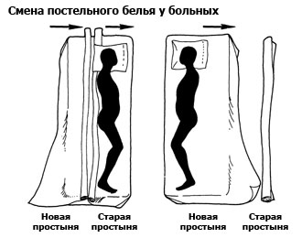
Change of bed and underwear
Seriously ill on bedrest change of bed linen by longitudinal method (2 nurses perform manipulation)
Purpose: maintain cleanliness, comfort and well-feeling of the patient.
Equipment: gloves, clean bed linen (pillowcase, 2 bed-sheets), container for dirty linen.
Algorithm:
1.Explain to the patient the purpose and procedure course. Obtain patient’s consent.
2.Conduct hygienic washing hand and processing hand. Put the gloves on. Wear apron.
3.Prepare clean bed linen, roll up a clean bed-sheet longwise to half.
4.Remove the blanket. Remove the bed-sheet from blanket.
5.A first the nurse lifts the head and shoulders of the patient.
6.A second nurse remove the pillow. Lower the patient's head.
7.Turn the patient on his side faced to you (1 nurse).
8.A second nurse rolls up a dirty sheet longwise to back of the patient.
9.A second nurse puts clean sheet on the bed with side of a patient's back (roller to roller).
10.Carefully move the patient on the clean bed-sheet.
11.Remove a dirty bed-sheet. Straighten out the clean bed-sheet at the other side.
12.Turn patient on his back.
13.Change pillowcase. Carefully lift the head and shoulders of the patient.
Put the pillow under his head. Put patient.
14.Tuck in the bed-sheets under the mattress.
15.Cover the a clean bed-sheet over the blanket.
16.Cover of patient by blanket.
17.Put the dirty bed linen in the container.
18.Remove gloves, put them in a container for disinfection.
The main place patients at the hospital is bed.
Change of bed and underwear is carried out:
once a week according to plan,
after taking a bath or shower,
in the case of dirtying of bed linen.
Seriously ill patients during the change of bed linen is in bed. Change of linens a seriously ill can be made in two ways. Change linens by a seriously ill can be made in two ways.

Slide 42
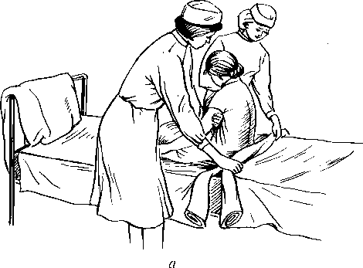
Seriously ill on strict bedrest; change of bed linen by cross method (2 nurses perform manipulation)
•Purpose: maintain cleanliness and good health of the patient.
•Equipment: gloves, clean bed linen (pillowcase, 2 bed-sheets), container for dirty linen.
Algorithm:
1.Explain to the patient the purpose and procedure course. Obtain patient’s consent.
2.Conduct hygienic washing hand and processing hand. Put the gloves on. Wear apron.
3.Prepare clean bed linen. Rolls up a clean sheet transverse to half.
4.Remove the blanket. Remove the bed-sheet from blanket.
5.First the nurse lifts the head and shoulders of the patient.
6.A second nurse remove the pillow.
7.A second nurse rolls up dirty bed-sheet to loin (lumbus).
8.Put the clean bed-sheet on bed with side of a patient's head (roller to roller).
9.Put patient.
10.Change the pillowcase. First the nurse lifts the head and shoulders of the patient.
11.A second nurse put the pillow under head. Put head of patient.
12.First the nurse lifts the pelvis of the patient, then the legs.
13.Remove the a dirty bed-sheet. Straighten out the clean sheet at the other side.
14.Lower legs.
15.Tuck in the bed-sheets under the mattress.
16.Cover the a clean bed-sheet over the blanket.
17.Cover of patient by blanket.
18.Put the dirty bed linen in the container.
19.Remove gloves, put them in a container for disinfection.
20.Wash hands hygienic way.
21.Make a note of the results in a medical documentation.

Slide 43
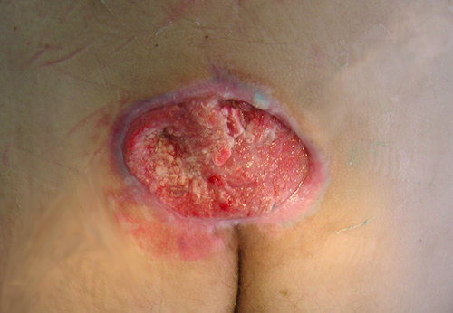
Pressure ulcers
Pressure ulcer is impaired skin integrity resulting from pressure.
Pressure ulcers, also known as pressure sores, bedsores
and decubitus ulcers.
Three etiological factor (etiology) of formation of pressure ulcers:
Pressure
Friction
Shearing force (shear tissues)

Slide 44
PRESSURE
Pressure is considered to be primary cause of the pressure ulcer. In a sick person, the areas of tissue resting against the mattress are vulnerable areas. The pressure in these areas causes depletion of blood supply with the failure of circulation (tissue ischemia). Tissue ischemia, decreased blood flow to tissue resulting in tissue death, occurs when capillary blood flow is obstructed, as in the case of pressure.
If this status lasts for more than 2 hours, there is ischemia, and then necrosis of the soft tissues.
The pressure over these areas are increased in the following conditions:
When there is lumps and creases on the bed.
Incorrect positioning of the body.
Infrequent change of position.
That’s why it is necessary to remember that a long lying or sitting still is dangerous!

Slide 45
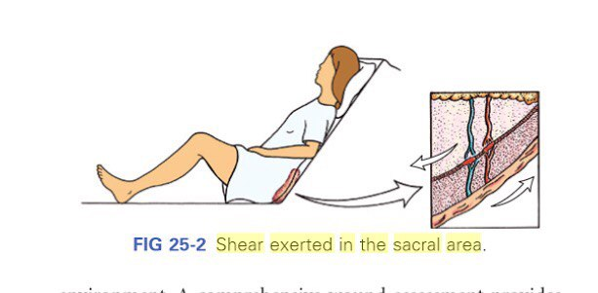
SHEARING FORCE
Shear. The force exerted against the skin while the skin remains stationary and the bony structures move is called shear. For example, the head of the bed is elevated, gravity causes the bony skeleton to pull toward the foot of the bed, while the skin remains the sheets.
The underlying tissue blood vessels are stretched and angulated, and blood flow is impeded to the deep tissue. Ulcers occur with large areas of undermined damage at the skin surface

Slide 46
FRICTION
Friction - an injury top layer of the skin caused by rubbing from two surfaces against one another.
In result appears abrasion.
The body surfaces most at risk for friction are the elbows and heels because abrasion of these surfaces occurs when they are rubbed against the sheets during repositioning.
A similar situation arises in those cases, when the patient rests on elbows and heels at the surface of the bed and tries to move. He slides, rubbing elbows and heels on bed sheets, there is a BURN from FRICTION. A similar situation occurs when a motionless patient on the bed pulling - is the friction skin on the sheet.

Slide 47
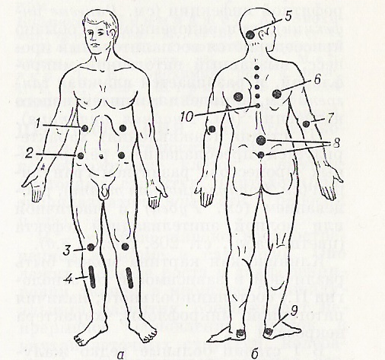
Places of formation of pressure ulcer
If the patient lies on his back - bedsore formed on the sacrum (8), heels (9), elbows (7), scapula (6), back of the head (5), spinous process of chest vertebras (10).

Slide 48
If the patient lies on his abdomen – bedsore formed on zygoma, tuber ischadicum (2), costal arch (1), knees (3), crus (4), and pubis.

Slide 49
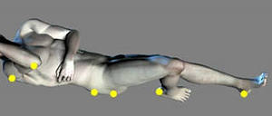
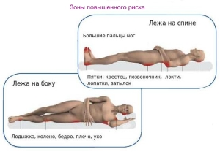
If the patient lies on one side - bedsore formed on the side of the thigh, on the sides of the malleolus and knees.

Slide 50
Factors contributing to the formation of pressure ulcer:
Age.
Cachexia (severe acute malnutrition)
Deficiency of protein and vitamins.
Chronic heart and lung failure.
Violation motor activity (diseases of the brain and spine)/
Diabetes.
Reduced blood flow in the lower and upper extremities.
Bad the care of critically ill: the presence in the bed of moisture, crumbs, wrinkles, stitches on the sheets.
Improperly moving a patient in bed (rude movements leads to injury to soft tissue).

Slide 51
Moisture
Moisture on the skin increases the risk for ulcer formation. Moisture reduces the skin's resistance to other physical factors such as pressure or shear. Moisture originates from wound drainage, perspiration (sweating), and\or fecal and urinary incontinence. Skin moisture and wetness from incontinence can cause skin breakdown.
Nutrition
Poor nutrition, specifically severe protein deficiency, causes soft tissue to become susceptible to breakdown. Low protein levels cause edema or swelling, which contributes to problems with oxygen transport and transport of nutrients.
Poor nutrition alters fluid and electrolyte balance. In patients with severe protein loss, hypoalbuminemia leads to a shift of fluid from the extracellular fluid volume to the tissues, resulting in edema.
Edema increases the affected tissue's risk for pressure ulcer formation. The blood supply to the edematous tissue is decreased, and waste products remain because of the changing pressure in the capillary circulation and capillary bed.

Slide 52
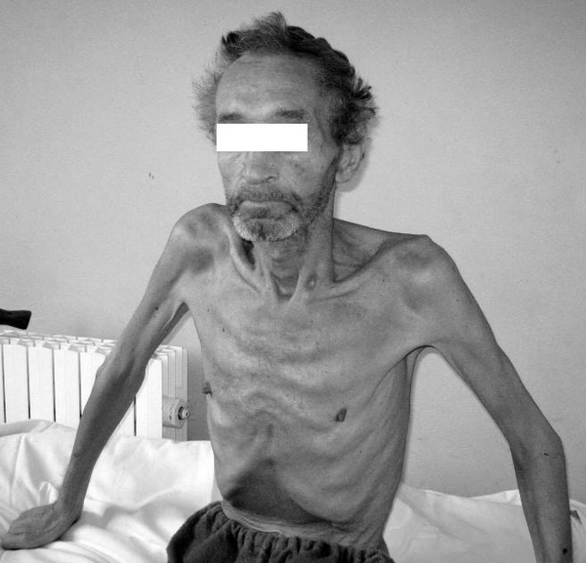
Cachexia
Cachexia is generalized ill health and malnutrition, market by weakness and emaciation, or extreme thinness. Basically the cachectic patient has lost the adipose tissue necessary to protect bony prominence from pressure and suffers from poor nutrition.
Age
Skin structure changes with age, causing a loss of dermal thickness and an increase in the risk for skin tears (break). Older adults are at highest risk for development of pressure ulcers; 60% to 90% of all pressure ulcers occur in patients over 65 years of age.

Slide 53
Pressure ulcer classification

Slide 54
PRINCIPLES OF PREVENTION OF BEDSORES
Identification of patients at risk of developing bedsores:
Waterlow scale
Norton scale)
Daily skin care in the typical places of formation of bedsores:
daily inspection of the skin
cleansing of the skin
protect of the skin (if the skin is damp - to dry, if the skin is dry - to moisten)
percussion massage (the intensification of local blood circulation in problem areas)
Reducing an etiological factor (pressure, friction or shear forces):
to use special device (anti-bedsore mattress, special pillows)
change position every 2 hours
Ensuring personal hygiene:
regular change of underwear and bed linen
hygiene of the perineum
the use of diapers, if necessary
Rational nutrition:
not less than 1.5 liters of fluid per day
fruits, vegetables, dairy products, fish, chicken

Slide 55
IDENTIFICATION OF PATIENTS AT RISK OF DIVELOPING BEDSORES
To select methods of prevention of bedsores, it is necessary to determine the risk of developing this complication. For this purpose, developed a variety of scales. The most famous of the Waterlow scale and the Norton scale.

Slide 56
Body type - body mass index | Average - 0
 | Above average - 1
 | Obesity - 2
 | Cachexia - 3
Skin | Healthy skin is 0
 | Thin, dry, swollen - 1
 | Color change - 2
 | Cracked, damaged skin - 3
Gender / Age | Male - 1
 | Female - 2
 | 14-49 - 1
 | 50-64 - 2
 | 65-74 - 3
 | 75 – 80 - 4
 | Over 81 - 5
Special risk factors | Terminal cachexia - 8
 | Heart failure - 5
 | Peripheral vascular disease - 5
 | Anemia - 2
 | Smoking 1
Incontinence of urine and feces | Full control - 0
 | Periodic incontinence - 1
 | urination through catheter - 2
 | Incontinence of feces and urine - 3
Mobility | Full mobility - 0
 | Restless patient - 1
 | a small limitation mobility - 2
 | Limited mobility - 3
 | paralyzed patient - 4
 | complete immobility - 5
The appetite, the ability to get food | Average - 0
 | Bad - 1
 | Artificial feeding (nasogastric tube, parenteral nutrition) - 2
 | Anorexia 3
Neurological disorders | Diabetes, atherosclerosis - 4
 | Stroke - 6
Major surgery, trauma | Operations on the joints, spine - 5
 | Duration of surgery more than 2 hours - 5
Drug therapy | Cytotoxic agents, steroids, antiinflammatory drug - 5
TOTAL POINTS | no risk of 1-9 points, medium risk - 10-14 points, high risk - 15-19 points, very high risk - above 20 points
Assessment of risk of developing pressure sores on a scale of Waterloo

Slide 57
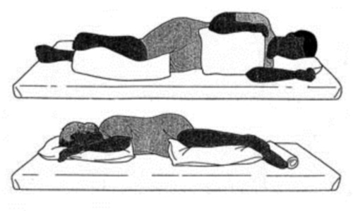
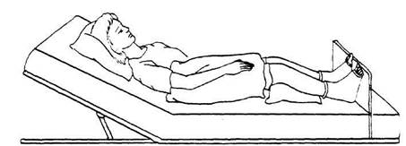
THE REDUCTION OF PRESSURE
1.The reduction of pressure on the skin in areas of bone protuberances is achieved by putting the patient on a soft but resilient surface. The mattress takes the body shape, increases the contact area and reduces pressure on protruding body parts. By taking low risk you can use a foam mattress. With a high degree of risk, and if the sores use special anti-bedsore mattress. When placing the patient in the wheelchair under the buttocks and behind your back place a foam cushion under the foot and enclose the foam pad.
2.It is necessary every 2 hours to change the body position of the patient, including at night. Remember! The main rule of moving the patient: the patient must be implemented carefully, eliminating shear and friction to tissues RAISING HIS ABOVE THE BED, or using the backing sheet.
The most common position: on her back; on her right side; on the left side, the sitting position; the position of the Fowler; the half-turn to right; turn left. In the last two positions of the body fixed with the use of pillows placed under the head, an arm and a leg (the Sims position).
The Sims position
The Fowler position

Slide 58
ACTIVATION OF BLOOD CIRCULATION
To activate local blood circulation use: three times daily massage of the skin with the use of special tools (oil for skin toning liquid, etc.);
Special exercises with change of active and passive movements;
Remember! Reddened skin never massage, useful only regular massage around these places.
СLEANSING AND SKIN PROTECTION
Wash skin to use PH neutral Soaps.
Carefully dry the skin absorbent movements.
To avoid excessive moisture or dryness of the skin: with dry - moisten with cream; moisture - use a powder without talc.
Incontinence of urine and feces is to use diapers.
BALANCED DIET
The diet should contain at least 120 grams of protein and 500-100 mg of ascorbic acid. Use dairy products, greens, vegetables, fruits. Should drink at least 1.5 liters of liquid, if there are no contraindications.

Slide 59
On prolonged disruption the skin cells suffer from lack of nutrition and die a slow death. In terminally ill patients it is very difficult to heal bed sores because it is rarely possible to move them around. However, in general bed sores are treatable if detected early.

